Slide 1
A Journey Through the Soundwaves: Uncovering Listening Habits from Spotify History
SQL case Study #1

Slide 2
Introduction
In a world where billions of tracks swirl through the digital airwaves, every click, pause, and skip tells a story—not just of music, but of mood, context, and choice. Spotify, a modern oracle of musical preference, holds within its logs a treasure trove of listener behavior, whispering tales of late-night jams, one-hit wonders, and songs that never made it past the first chorus.
This dataset isn’t just about music. It’s about moments—a long commute, a spontaneous dance in the kitchen, background beats while working, or heartache on a rainy day. Each song played (or skipped) paints a piece of that moment. Hidden in those milliseconds played, platforms used, and shuffle settings are patterns waiting to be discovered.
What makes a listener hit “next”? When do they stay for the full song? Is it the time of day? The platform? Or the track itself?

Slide 3
Problem Statement
🕵️‍♂️ The Mystery
Not every song made it to the end. Some were skipped within seconds, others played all the way through. Some were handpicked, others auto-played by the platform. What if we could predict which songs are destined to be skipped and which ones hit just right?
💡"Can we understand and predict listener behavior—especially track skipping—based on play context such as time of day, platform used, playback duration, and how the track started?"
🎯 The Mission
By exploring these patterns, we aim to predict skip behavior and uncover what keeps listeners tuned in. This isn’t just about the songs—they’re the soundtrack. This is about the listener, their habits, moods, and choices.
And if we can understand them, maybe we can recommend their next favorite song—before they even know they need it.

Slide 4
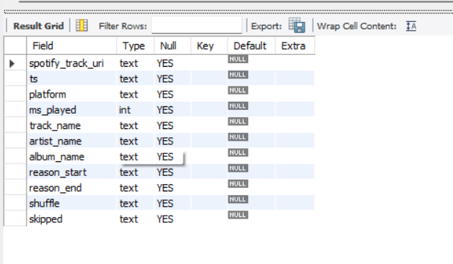
Dataset

Slide 5
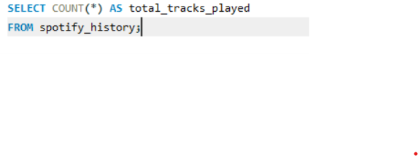
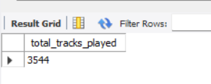
How many tracks were played in total?

Slide 6
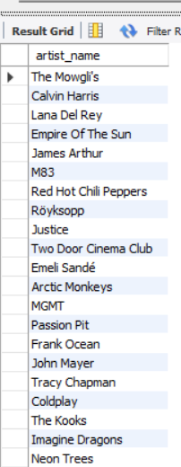

List the unique artists in the dataset.

Slide 7


Find the most frequently played track and its artist.

Slide 8
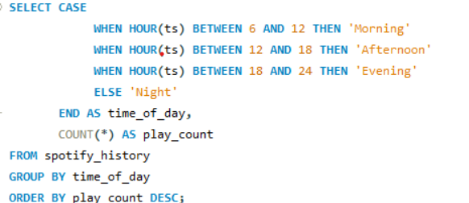
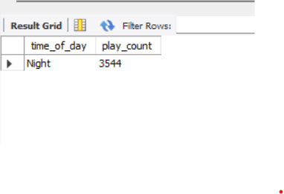
What time of day do they typically listen to music?

Slide 9
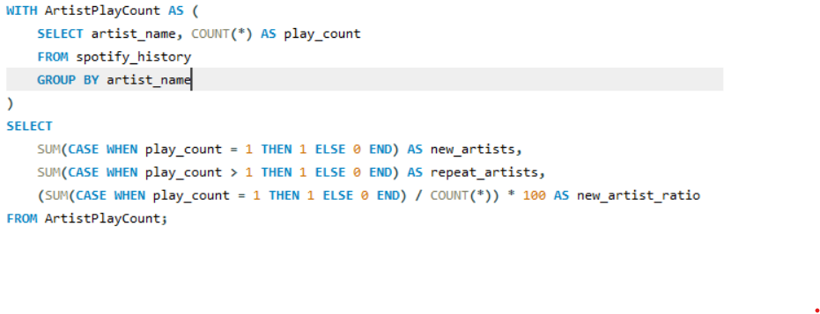
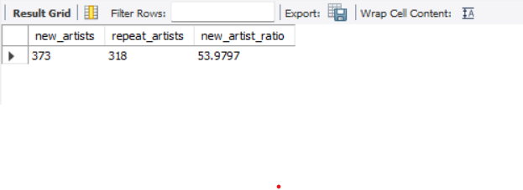
How often do they explore new artists versus replaying favorites?

Slide 10
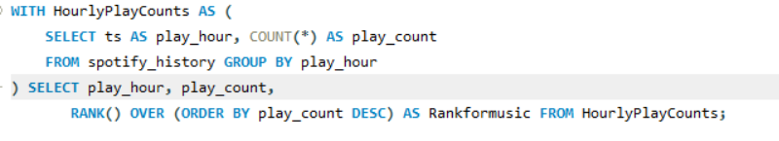
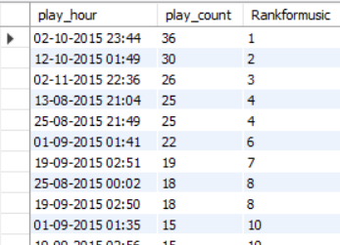
User Engagement Trends
A. Identify Peak Listening Hours (Hourly Trend) Purpose: Identifies the hours when users are most active, ranking them from highest to lowest.

Slide 11
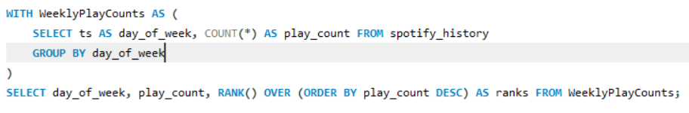
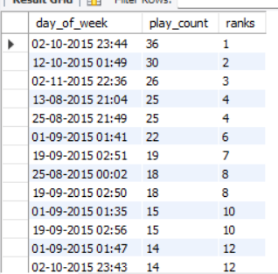
B.Weekly Listening Trends Purpose: Determines which day of the week users are most engaged.

Slide 12
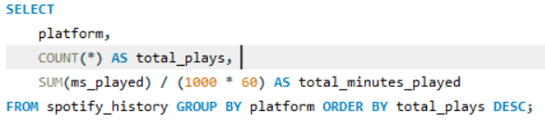
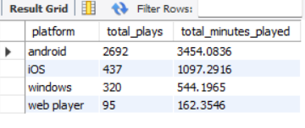
C.Platform-Based User Engagement Purpose: Identifies which platforms users prefer for streaming.

Slide 13
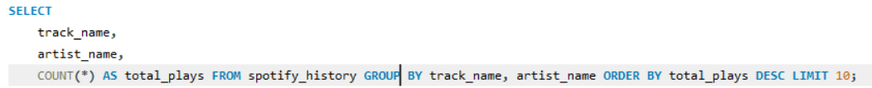
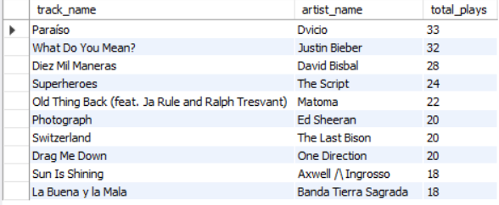
Listening Behavior Analysis
A. Most Played Tracks Purpose: Finds the top 10 most played songs along with their respective artists.

Slide 14
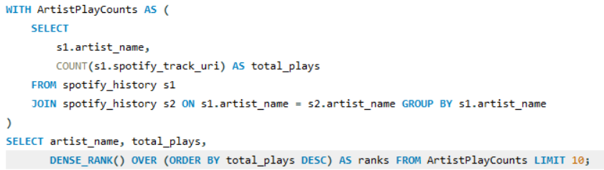
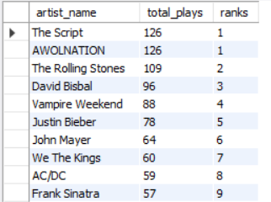
C.Most Played Artists Purpose: Finds the top 10 most played artists. Using Window and Self Join

Slide 15
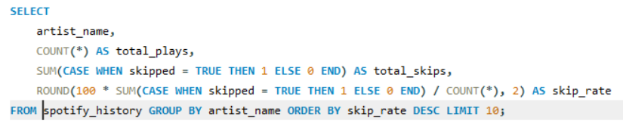
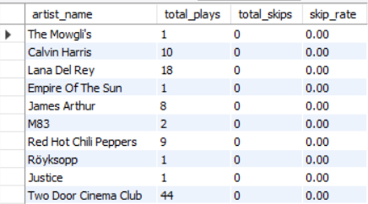
Skip Rate Analysis Purpose: Identifies artists with the highest skip rates.

Slide 16
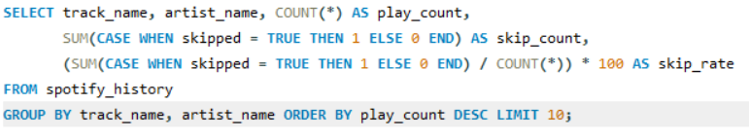
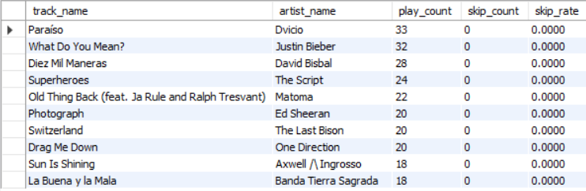
Which songs have they played the most? How often do they skip them?

Slide 17
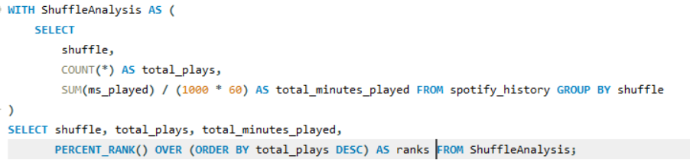

Impact of Shuffle Mode Purpose: Determines how shuffle mode affects listening behavior

Slide 18
Conclusion
This MySQL case study uses Joins, CTEs, and Window Functions to analyze User Engagement Trends and Listening Behavior. Key takeaways include:
Peak listening hours and days help in content promotion strategies.
Platform analysis guides optimizations for different devices.
Identifying top artists, albums, and tracks helps in recommendations.
Understanding skip rates assists in refining playlists and improving user experience.
Analyzing shuffle behavior reveals user preference for algorithmic vs. manual playback.

